Slide 1
Nodule Detector
1.0

Slide 2
What is a Nodule?
A Nodule can be simply described as a growth of abnormal tissue that can appear on the skin ,armpits and internal organs.
We are not really concerned about what causes this or the biology and all the information radiologists study.

Slide 3
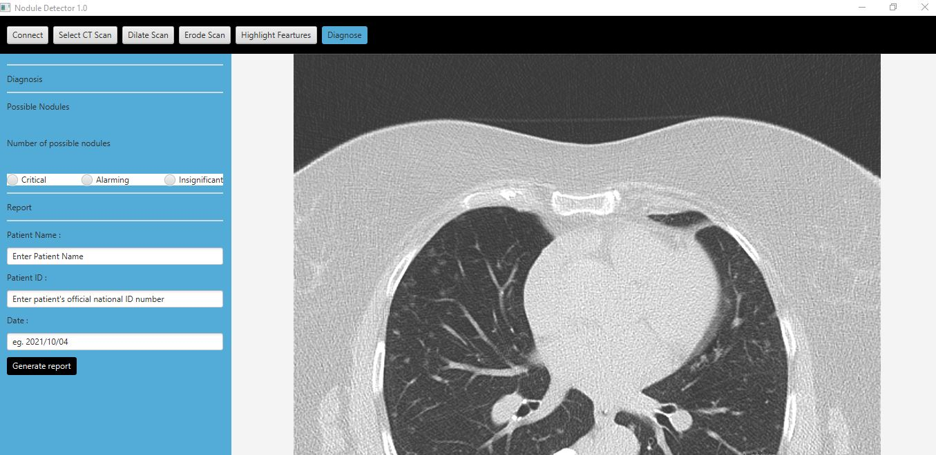
Meet the Nodule Detector 1.0

Slide 4
What does the Nodule Detector do?
The Nodule Detector helps with identifying/Highlighting nodules on CT scans done on patients.
It also helps generate a quick report on the findings from the provided CT scan with just a few clicks.
The rate at which radiologists will be able to identify nodules will increase thus increasing productivity and overall performance of the organisation.
Hospitals can use this to eventually replace the labour of finding nodules for radiologists as the technology will develop.

Slide 5
How is the detection done?
The Nodule Detector consumes an API provided by Mr Moodley.
This API helps by providing useful image editing functions which are then used to identify these nodules.
After all the relevant editing the radiologist will be able to click the “Diagnose” button to get a rough diagnosis of the provided CT scan

Slide 6
How do we use the Nodule Detector 1.0?
Firstly , users can select the CT scan of relevance by clicking on the “SELECT SCAN: button

Slide 7
Next…
The user must connect to the API then
When the acknowledgment message appears in the “Log” the user can start applying the editing to the CT scan.

Slide 8
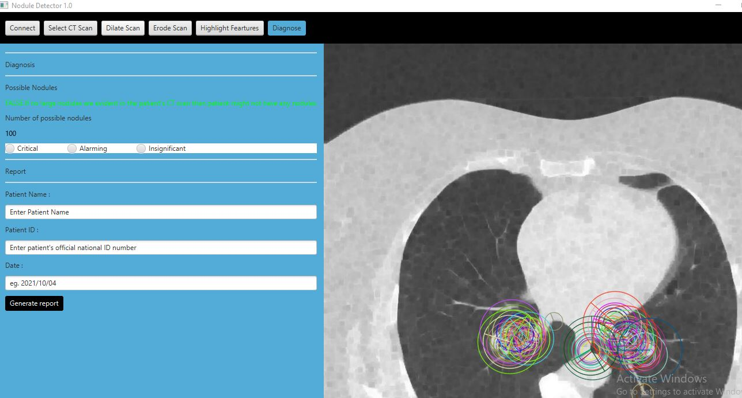
Lastly…
The edited scan with the rough diagnosis will appear and then the radiologist after further inspection of the CT scan will be able to say whether the nodules detected are of significance or not.
Then the radiologist can fill in the details of the patient to have the report generated.

Slide 9
Thank you for your time.
Credits
Beast Technologies.
Mr Moodley.
UJ
Video Link: https://drive.google.com/file/d/1VSEeNA8COH0LrqjnC2SNEeMr84knLVPU/view?usp=drivesdk
Video Link :
https://www.dropbox.com/request/Pxv50hEJ3Rd60zCrGZYB

